Slide 1
MCSE Guide to Microsoft Windows 7
Chapter 6
User Management

Slide 2
Objectives
Describe local user accounts and groups
Create and manage user accounts
Manage Profiles
Describe Windows 7 integration with networks
Configure and use Parental Controls

Slide 3
User Accounts
User account
Required for individuals to log on to Windows 7 and use resources on the computer
Has attributes that describe user and control access
Local user accounts
User accounts created in Windows 7
Exist only on the local computer
User accounts are stored in the Security Accounts Manager (SAM) database
Within the SAM database, each user account is assigned a Security Identifier (SID)

Slide 4
Logon Methods
Windows 7 configurations
Standalone
Workgroup member
Domain client

Slide 5
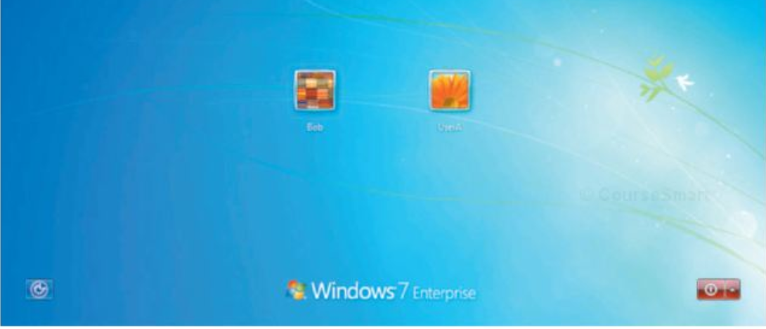
Logon Methods (cont'd.)
Windows Welcome
Logon method used by standalone computers and workgroup members
Authenticates users by using local SAM database

Slide 6
Logon Methods (cont'd.)
Secure Logon
Increases security on your computer by forcing you to press Ctrl+Alt+Delete before logging on
Protects your computer from viruses and spyware that may attempt to steal your password
When the computer is a domain client, then secure logon is required
Fast User Switching
Allows multiple users to have applications running in the background at the same time
One user can be actively using the computer at a time

Slide 7
Logon Methods (cont'd.)
Automatic Logon
Sometimes it is desirable for the computer to automatically log on as a specific user
Each time it is started
Automatic logon is configured on the Users tab of the User Accounts applet
Holding down the Shift key during the boot process stops the automatic logon from occurring

Slide 8
Naming Conventions
Naming convention
Standard process for creating names on a network or standalone computer
Even small networks benefit from resources with meaningful names
Some common naming conventions
First name
First name and last initial
First initial and last name

Slide 9
Naming Conventions (cont'd.)
Restrictions imposed by Windows 7
User logon names must be unique
User logon names must be 20 characters or less
User logon names are not case sensitive
User logon names cannot contain invalid characters

Slide 10
Default User Accounts
Administrator
Most powerful local user account possible
Unlimited access and unrestricted privileges to every aspect of Windows
Characteristics
Not visible on the logon screen
Has a blank password by default
Cannot be deleted
Cannot be locked out due to incorrect logon attempts
Cannot be removed from local administrators group
Can be disabled
Can be renamed
Disabled by default in Windows 7

Slide 11
Default User Accounts (cont'd.)
Guest
One of the least privileged user accounts in Windows
Has extremely limited access to resources and computer activities
Intended for occasional use by low-security users
Characteristics
Cannot be deleted
Cannot be locked out
Is disabled by default
Has a blank password by default
Can be renamed
Is a member of the Guests group by default
Is a member of the Everyone group

Slide 12
Default User Accounts (cont'd.)
Initial Account
User created during installation is given administrative privileges
Initial Account is different from Administrator account in that it:
Is visible on the logon screen
Does not have a blank password by default
Can be deleted
Can be locked out due to incorrect logon attempts
Can be removed from the Administrators group

Slide 13
Default Groups
Groups are used to simplify the process of assigning security rights and permissions
Members of a group have access
To all resources that the group has been given permissions to access
Windows 7 built-in groups
Administrators
Backup Operators
Cryptographic Operators
Distributed COM Users

Slide 14
Default Groups (cont'd.)
Windows 7 built-in groups (cont'd.)
Event Log Readers
Guests
IIS_IUSRS
Network Configuration Operators
Performance Log Users
Performance Monitor Users
Power Users
Remote Desktop Users
Replicator
Users

Slide 15
Creating Users
Creating a user can be done from:
Control Panel
Local Users and Groups MMC snap-in
Advanced User Accounts applet
Standard user account
Derives its privileges from being a member of the local Users group
Cannot compromise the security or stability of Windows 7
Administrator account
Derives its privileges from being a member of the local Administrators group
Has complete access to the system
Most actions that are triggered by an Administrator do not result in a prompt from User Account Control
Changes triggered by software do result in a prompt from User Account Control

Slide 16
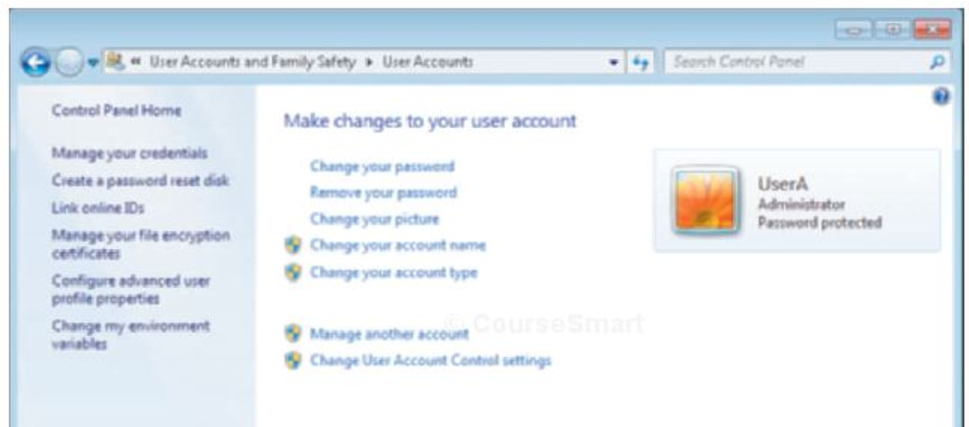
User Accounts Applet
User Accounts applet in Control Panel
Simplified interface for user management
Users can perform basic administration for their accounts using this interface
Administrative options with a shield beside them are restricted to administrative users

Slide 17
Local Users and Groups MMC Snap-In
Allows you to create and manage both user accounts and groups
General user tasks you can perform
Create a new user
Delete a user
Rename a user
Set a user password

Slide 18
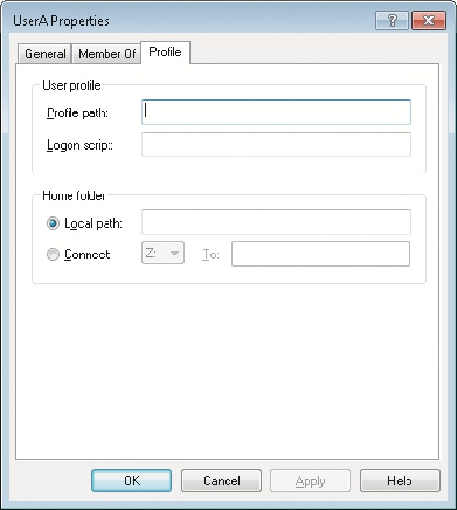
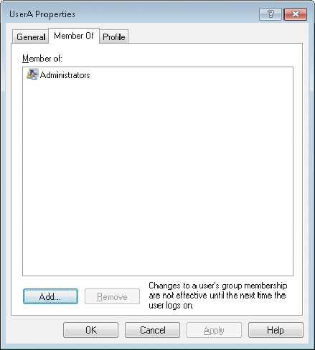
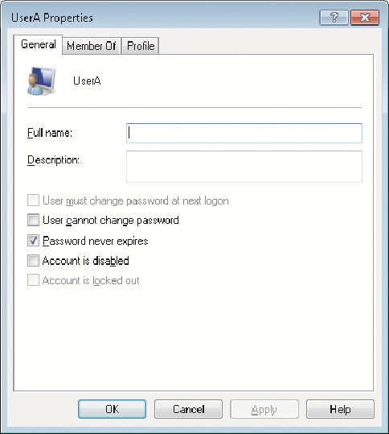
Local Users and Groups MMC Snap-In User Properties Dialog Box
General Tab
Change full name
Control password
Member Of tab
Lists groups of which the user account is a member
Any rights and permissions assigned to these groups are also given to the user account
Profile tab
Often used in corporate environments for domain-level accounts
Profile path specifies location of profile for this user
By default, profiles are stored in C:\Users\%USERNAME%

Slide 19
Local Users and Groups MMC Snap-In User Properties Dialog Box (cont'd.)
In addition the Profile tab has
Logon script box
Defines a script that is run each time during logon
Home folder
Defines a default location for saving files

Slide 20
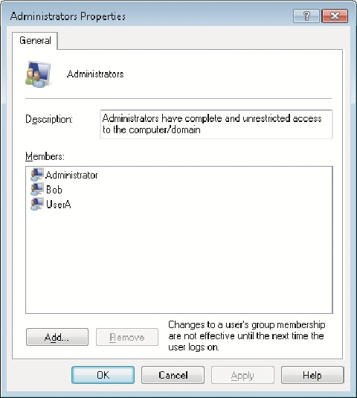
Local Users and Groups MMC Snap-In Group Properties Dialog Box
When you view the properties of a group, there is only a single tab
Provides a description of the group and a list of the group members
You can add and remove users from the group here

Slide 21
Advanced User Accounts Applet
Available only by starting it from the command line
To start the advanced User Accounts applet from a command line, use the netplwiz command

Slide 22
Managing Profiles
User profile
Collection of desktop and environment configurations for a specific user or group of users
By default, each user has a separate profile stored in C:\Users
Profile folders and information found in a User Profile (see page 263 for detailed explanation for each folder).
AppData
Application Data
Contacts
Cookies

Slide 23
Managing Profiles (cont'd.)
Profile folders and information found in a User Profile (cont'd.)
Desktop
Documents
Downloads
Favorites
Links
Local Settings
Music
My Documents
NetHood

Slide 24
Managing Profiles (cont'd.)
Profile folders and information found in a User Profile (cont'd.)
Pictures
PrintHood
Recent
Saved Games
Searches
SendTo
Start Menu
Templates
Videos

Slide 25
Managing Profiles (cont'd.)
Profile folders and information found in a User Profile (cont'd.)
NTUSER.DAT
NTUSER.DAT.LOG
NTUSER.DAT{guid}.TM.blf
NTUSER.DAT{guid}.TMContainerxxxxxx.regtrans-ms
Ntuser.ini

Slide 26
The Default Profile
Default profile: when new user profiles are created
Windows 7 copies the default user profile to create a profile for the new user

Slide 27
Roaming Profiles
Roaming profile
Stored in a network location rather than on the local hard drive
Settings move with a user from computer to computer on the network
Useful when a corporation uses Outlook and Exchange for an e-mail system
To configure a roaming profile
You must edit the user account to point the profile directory at a network location
A roaming profile is copied to the local computer

Slide 28
Mandatory Profiles
Mandatory profile
Profile that cannot be modified
Users can make changes to their desktop settings while they are logged on
But the changes are not saved
Most mandatory profiles are implemented as roaming user profiles
To change a profile to a mandatory profile, you rename the file NTUSER.DAT to NTUSER.MAN

Slide 29
The Public Profile
Public profile
Different from other profiles because it is not a complete profile
Does not include an NTUSER.DAT file and consequently does not include any registry settings

Slide 30
The Public Profile (cont'd.)
Public profile folders (cont'd.)
Favorites
Libraries
Public Desktop
Public Documents
Public Downloads
Public Music
Public Pictures
Public Recorded TV
Public Videos

Slide 31
The Start Menu
Start menu
Collection of folders and shortcuts to applications
Modifying the Start menu is as simple as creating folders and shortcuts
Users all have a personal version of the Start menu that is stored in their profile
Use Windows Explorer to access and modify the contents of the Start Menu

Slide 32
Network Integration
User logon and authorization is very different in a networked environment
Network types
Peer-to-peer
Domain-based

Slide 33
Peer-to-Peer Networks
Peer-to-peer network (or workgroup)
Consists of multiple Windows computers that share information
No computer on the network serves as a central authoritative source of user information
Each computer maintains a separate list of users and groups in its own SAM database
Most commonly implemented in homes and small offices
Windows 7 has a limit of 20 connections

Slide 34
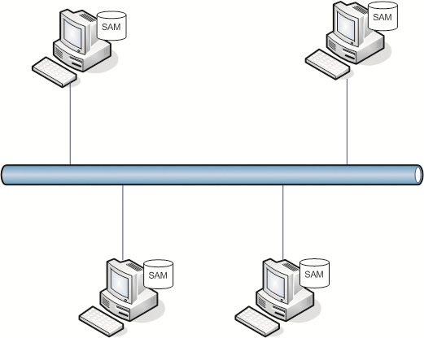
Peer-to-Peer Networks (cont'd.)

Slide 35
Peer-to-Peer Networks (cont'd.)
Access shares or printers on a remote computer
You must log on as a user that exists on the remote computer
Pass-through authentication
Simplest authentication method for users
Remote computer has a user account with the exact same name and password as the local machine
No automated mechanism to synchronize user accounts and passwords between computers

Slide 36
Domain-Based Networks
User accounts for domain-based networks are much easier to manage
Domain controller
Central server responsible for maintaining user accounts and computer accounts
Computers in the domain share the user accounts on the domain controller
User accounts only need be created once
No concerns about synchronizing passwords between multiple accounts

Slide 37
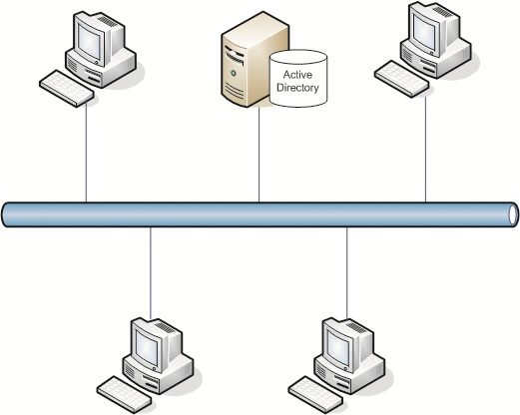
Domain-Based Networks (cont'd.)

Slide 38
Domain-Based Networks (cont'd.)
To participate in a domain
Windows 7 computers are joined to the domain
Domain Admins group becomes a member of the local Administrators group
To allow centralized administration by the domain administrators
Domain Users group becomes a member of the local Users group
To allow all users in the domain to log on to Windows 7

Slide 39
Cached Credentials
When you use Windows 7 and log on to a domain
Your authentication credentials are automatically cached in Windows 7
Important for mobile computers that are not always connected to the domain
After credentials are cached locally
You can log on to a computer using a domain user account
Even when the domain cannot be contacted

Slide 40
Parental Controls
Parental Controls
Method for controlling how Windows 7 is used by specific user accounts
The accounts must be Standard user accounts
Tasks performed with Parental Controls
Configure time limits
Control game playing
Allow and block programs

Slide 41
Time Limits
Time limits
Control when a user is able to log on and use the computer
Allow you to restrict logons to certain times of the day
The times can vary for each day

Slide 42
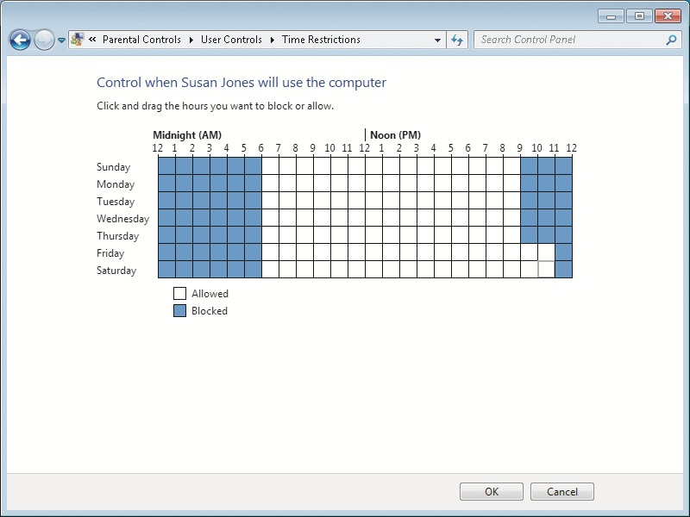
Time Limits Window

Slide 43
Game Controls
Game controls are used to limit access to games
You can block games based on the game rating
Default ratings
Early Childhood (EC)
Everyone (E)
Everyone 10+ (E10+)
Teen (T)
Mature (M)
Adults Only (AO)

Slide 44
Game Controls (cont'd.)
Additional categories
Online Rating Notice
Blood and Gore
Drug Reference
Intense Violence
Nudity
Real Gambling
Sexual Violence
Use of Alcohol
Use of Tobacco

Slide 45
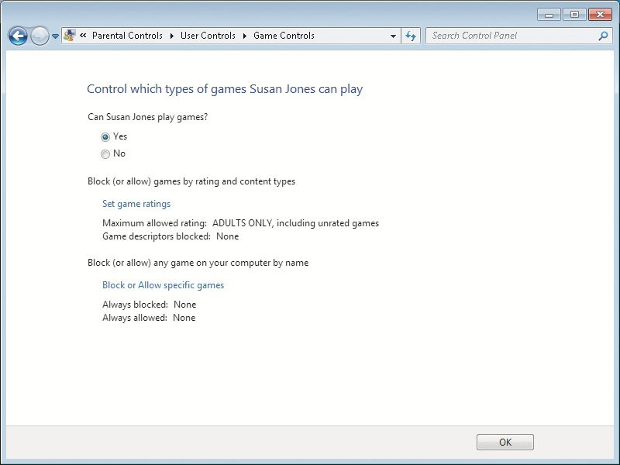
Game Controls Window

Slide 46
Block Programs
By default, users can run all programs that are installed
You can restrict users to running only approved applications
You can manually add programs to the list of approved applications

Slide 47
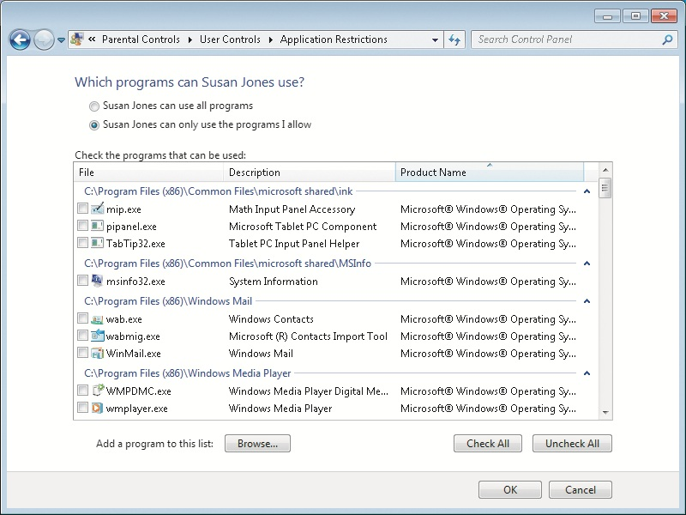
Block Programs Window

Slide 48
Summary
User accounts are required for users to log on to Windows 7 and use computer resources
Windows 7 log on security can be enhanced by enabling secure logon
Fast user switching allows multiple users to be logged on to a computer at the same time
Three default accounts are created upon installation of Windows 7: Administrator, Guest, and the initial user account

Slide 49
Summary (cont'd.)
Groups help simplify management by organizing users
Users can be created from Control Panel, the User and Groups MMC snap-in, or the advanced User Accounts applet
User profiles store user-specific settings
You can modify profiles to make them mandatory or roaming
In a peer-to-peer network, each computer authenticates users using the local SAM database

Slide 50
Summary (cont'd.)
In a domain-based network, user authentication is controlled centrally by a domain controller
Parental Controls allow you to configure time limits, control game playing, and allow or block programs

